Slide 1

Summary for last time
The DyNeMo (Dynamic Network Modes) model is a generative model under Bayesian framework designed for neuroimaging data analysis. It describes the time-varying statistical properties of time series data by linearly mixing a set of static spatial brain activity patterns, known as modes(μ, D). The modes are static, but the dynamism is reflected in the mixing coefficients. DyNeMo employs a Recurrent Neural Network (RNN) to simulate the temporal evolution of these coefficients. At each time point, logits(θ), which can be considered as latent variable, controled by a multivariate normal distribution, are transformed into mixing coefficients(α) via softmax operation. DyNeMo utilizes Bayesian methods for inferring the parameters of the generative model and is trained by minimizing variational free energy using stochastic gradient descent. The model's key feature is its ability to capture complex temporal structures and non-mutually exclusive mode activations.
Some extra summary: Logit represents an instance of latent variables that are not directly observed data but are inferred from the observed data. These logits are predicted by the output of a neural network (such as an RNN) and are used to determine the parameters of the multivariate normal distribution, thereby affecting how the model generates data. Therefore, although the logit in some sense represents a "decision" or "state" of the model, they are still considered implicit in the context of the model because they are inferred rather than directly observed amount.
In the DyNeMo model, logits can be understood as the underlying parameters of a multivariate normal distribution. They serve as a summary of temporal features. The term 'logit' was chosen by the authors not to specify the exact nature of these parameters but to describe their role and function in the model as inferred, latent parameters that explain and simulate the dynamics in neuroimaging data.

Slide 2
Simulations
Simulation 1: Long-range dependencies - This simulation was designed to assess DyNeMo's ability to capture long-range temporal dependencies in data. It used a Hidden Semi-Markov Model to generate data with state lifetimes that were explicitly modeled, allowing for the creation of long-lived states.
( "state lifetimes" refer to the duration of time that a system remains in a particular state before transitioning to another state. In neuroimaging data analysis, these states can represent different brain activity patterns or modes. )
Simulation 2: Linear mode mixing - The second simulation focused on DyNeMo's capacity to infer a linear mixture of co-activating modes. It simulated a set of sine waves to represent logits, which were then used to generate mixing coefficients through a softmax operation. This simulation tested DyNeMo against the limitations of traditional Hidden Markov Models (HMMs) in modeling co-activating modes due to their inherent assumption of mutual exclusivity.
Real data: Resting-State MEG Data - In addition to the simulation datasets, DyNeMo was applied to real Magnetoencephalography (MEG) data in both resting-state and task scenarios. This real-world application was aimed at demonstrating DyNeMo's utility in statistical studies, particularly in identifying plausible resting-state networks.

Slide 3
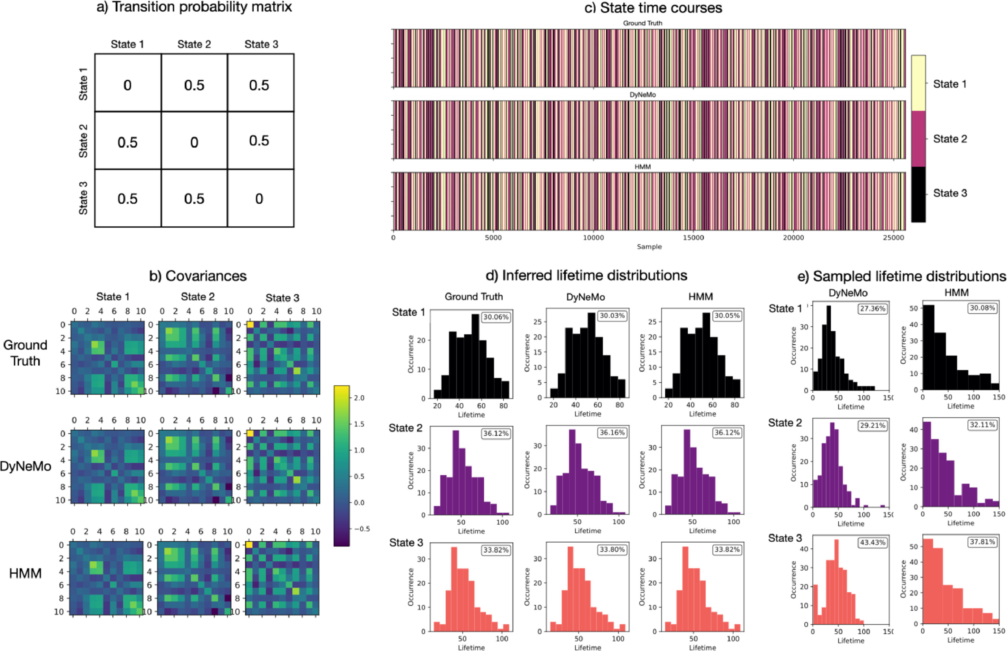
Result 1
Transition Probability Matrix (a): This matrix describes the probability of transitioning from one state to another.
Covariances (b): This shows the covariance matrices for the three states. The first row is the true data from the simulation, the second row is the data inferred by DyNeMo, and the third row is the data inferred by HMM.
State Time Courses (c): Different colors bars indicate the time courses of different states. The top of the figure represents the true data simulated, the middle represents data inferred by DyNeMo, and the bottom represents data inferred by HMM.
Inferred Lifetime Distributions (d): These histograms show the expected duration of each state, based on the hidden state sequences inferred by the models from the data. Both DyNeMo and HMM can infer lifetime distributions, but their accuracy may vary.
Sampled Lifetime Distributions (e): Compared to the inferred lifetime distributions, these histograms show the lifespan of states based on new data sequences generated by the models. This demonstrates how the models internally represent the duration of states and can reproduce these characteristics when generating new data.

Slide 4
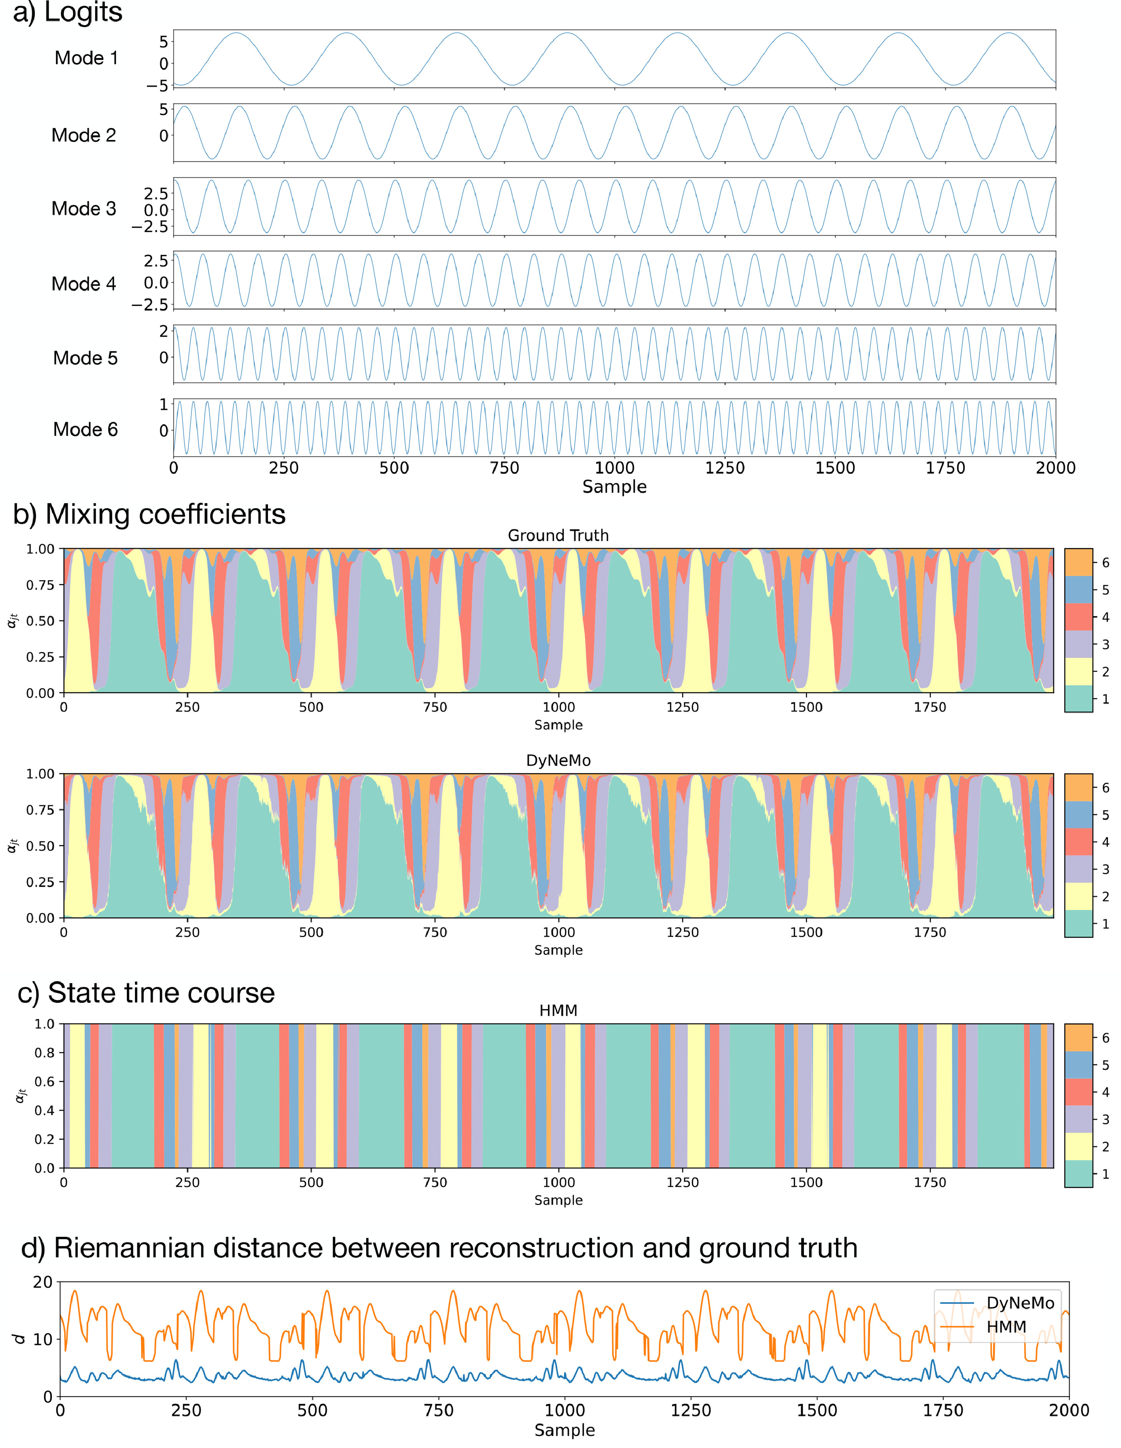
Result 2
a) Logits: This panel displays time series for six different modes, each with its own distinct oscillation pattern.
b) Mixing Coefficients: The top chart shows the "true" mixing coefficients used in the simulation, while the bottom chart shows the mixing coefficients as inferred by DyNeMo. These coefficients determine the contribution of each mode to the observed data at each time point.
c) State Time Course: Inferred by HMM, this chart shows the probability of each state over time. Different colors represent different states, and the width of the colored bands indicates the probability of each state at any given time point.
d) Riemannian Distance between Reconstruction and Ground Truth: This graph shows the Riemannian distance between the time-varying covariance reconstruction by DyNeMo and HMM compared to the ground truth. The Riemannian distance measures the difference between two covariance matrices and is used here to assess the accuracy of the model reconstruction against the actual simulation data.

Slide 5
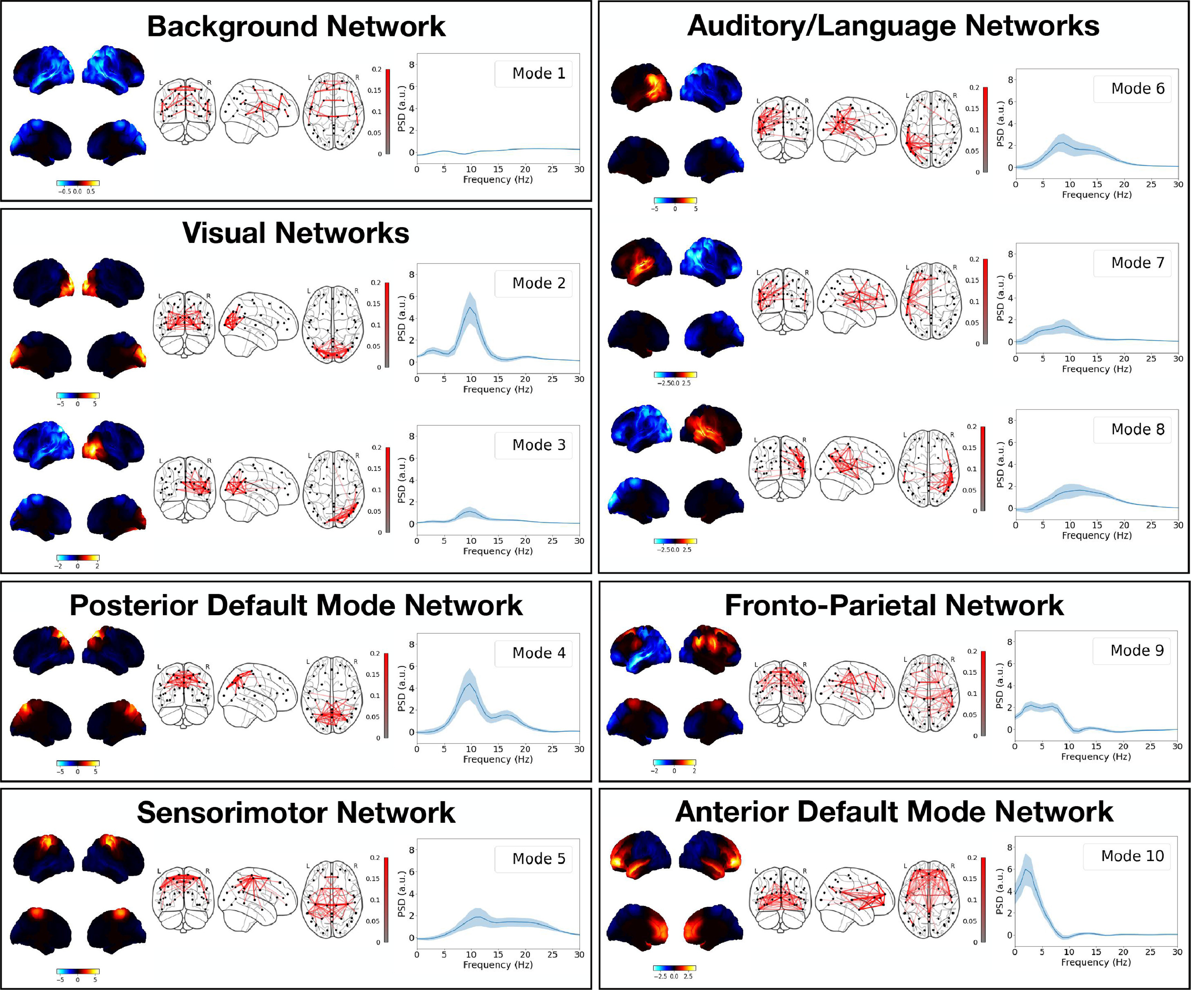
Result 3
The Power Spectral Density (PSD) averaged over values indicates the distribution of power across frequencies in a signal or time series. It represents how the power of the signal is distributed across various frequency components. For MEG data of brain activity, the PSD can show the intensity of activity in different brain regions at various frequencies.
The averaged PSD refers to the mean of the power values at each frequency point, calculated over multiple samples or measurements. For instance, in the analysis of MEG data for brain activity, one might focus on the average PSD in specific brain regions during a resting state. This can be obtained through the following steps:
step1 : Compute the power spectrum for MEG data from the brain regions of interest using Fourier transform or another type of frequency domain transformation.
step 2: Average the power values at each frequency point to get an overall PSD curve, reflecting the distribution of average power across frequencies.
step 3: Repeat the above steps for multiple subjects or multiple measurements, then compute the mean to obtain a general PSD curve.

Slide 6
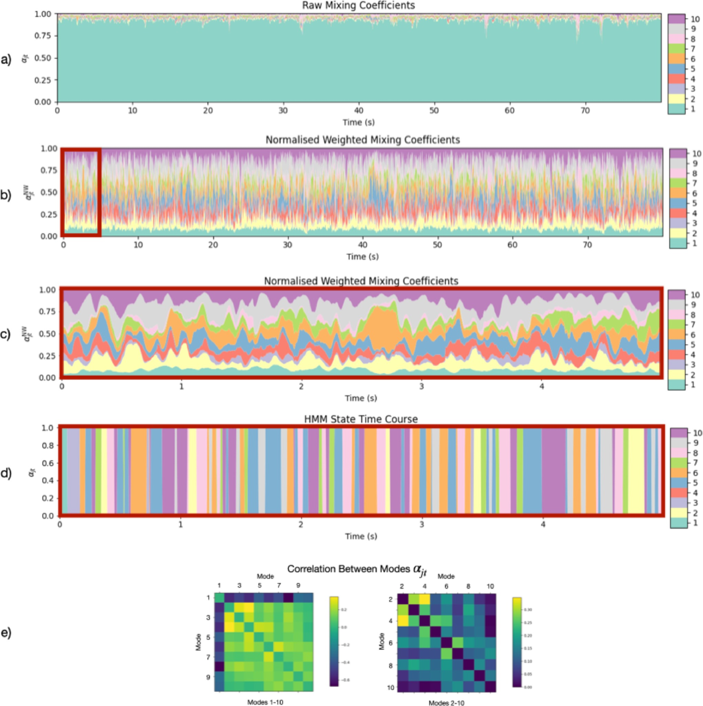
Result 3
This image illustrates how DyNeMo characterizes modes within resting-state MEG data. The details include:
a) Raw Mixing Coefficients (α_{jt}): The raw mixing coefficients inferred by DyNeMo for an individual subject.
b) Weighted Mixing Coefficients: Mixing coefficients αjt weighted by the trace of each mode's covariance and normalized to sum to one at each time point.
c) Zoomed-in Normalized Weighted Mixing Coefficients (α_{jt}): A zoomed-in view displaying the normalized weighted mixing coefficients for the first 5 seconds.
d) HMM State Time Course: For comparison, the HMM state time course is shown for the first 5 seconds. The power/functional connectivity (FC) maps and power spectral densities (PSDs) for the HMM states are presented in Figure S7.
e) Correlation between Raw Mixing Coefficients (α_{jt}) for Different Modes (j): The ordering is consistent with Fig. 6. We observe that DyNeMo's description of the data constitutes a set of co-existing modes whose contributions to the time-varying covariance fluctuate. Once weighted by the covariance matrices, each mode exhibits a more equal contribution. It is also noted that modes 2–10 are anti-correlated with mode 1, and modes with activation in similar regions, e.g., modes 2, 3, and 4, are correlated.

Slide 7
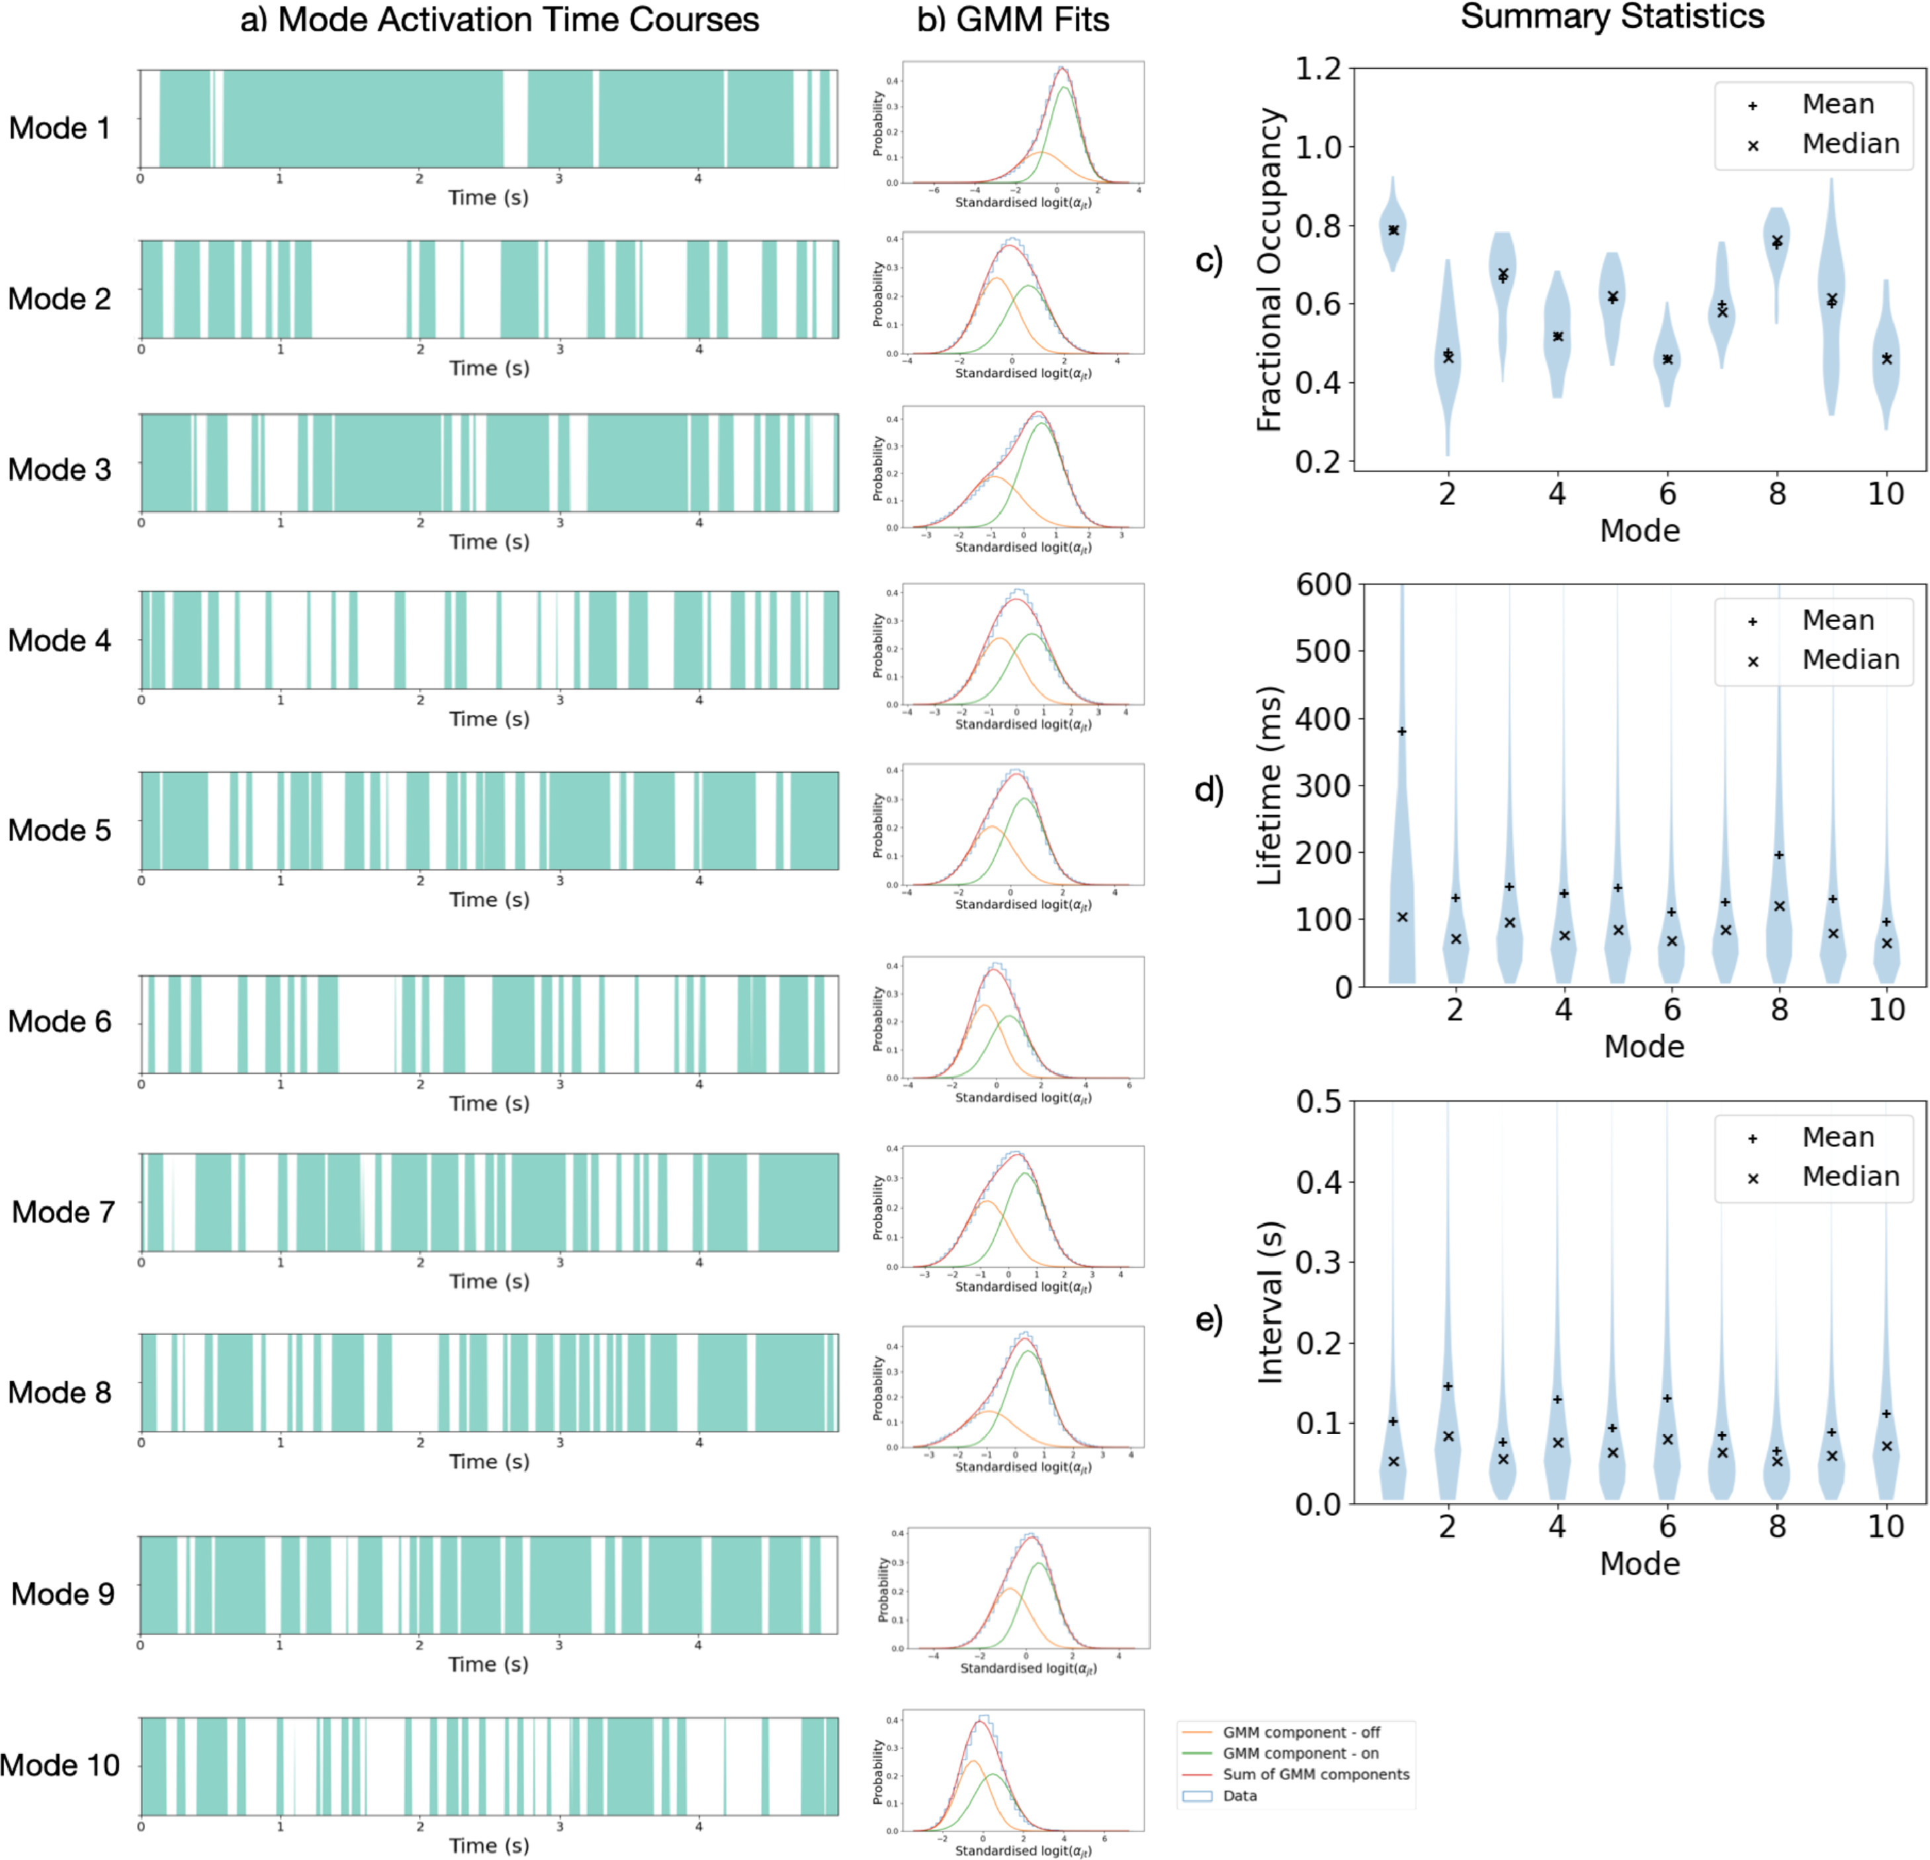
Result 3
It demonstrates how DyNeMo reveals short-lived mode activations with lifetimes of 100–150 milliseconds.
a) Mode Activation Time Courses: Turquoise regions indicate when a mode is "active". Only the first 5 seconds of each mode's activation time course for the first subject is shown.
b) GMM Fits: Gaussian Mixture Model (GMM) fits used to identify mode "activations".
c) Mode Activation Lifetimes Distribution: Shows the distribution of mode activation lifetimes across all activations and subjects.
d) Intervals Distribution: Displays the distribution of intervals between mode activations.
e) Fractional Occupancies Distribution: Illustrates the distribution of fractional occupancies across subjects.
It is noted that Mode 1 has a significantly longer mean lifetime (approximately 400 milliseconds) as compared to the other modes (approximately 100–150 milliseconds). There is also a wide distribution of fractional occupancies across subjects.

Slide 8
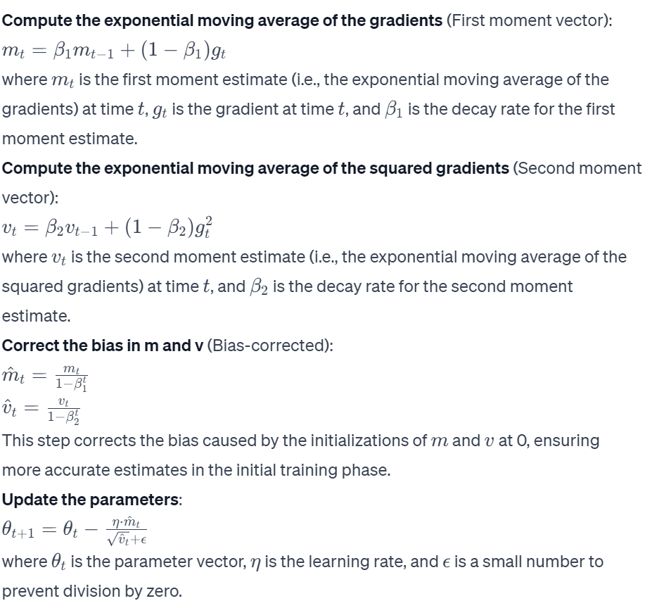
Supplementary Information
The Adam optimizer (Adaptive Moment Estimation)

Slide 9
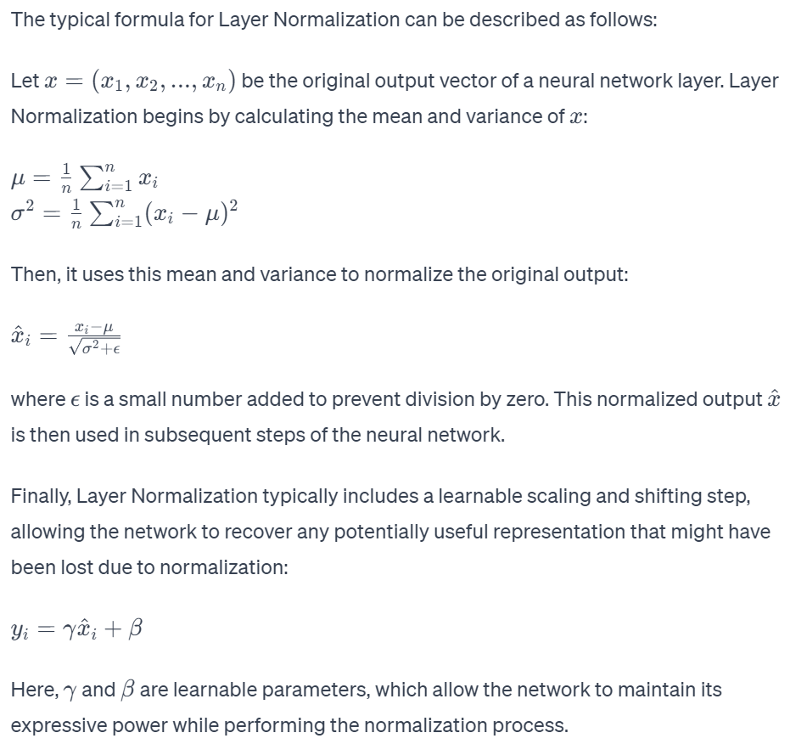
Layer Normalization

Slide 10
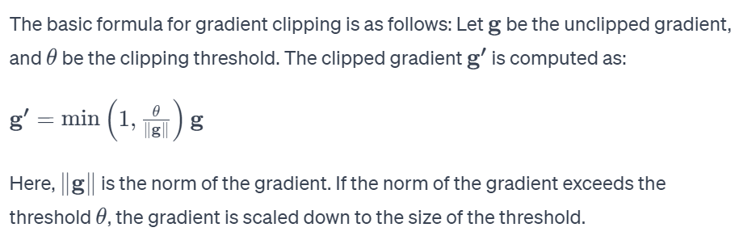
Gradient Clipping

Slide 11
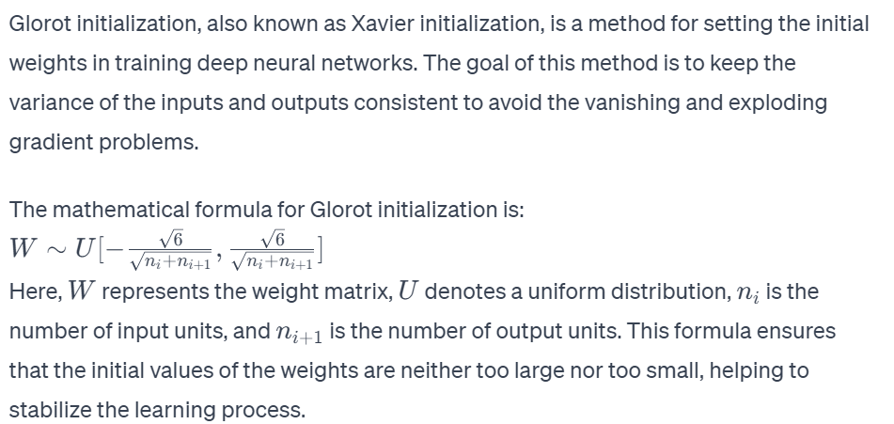
Glorot initialization
Learnt Affine Transformations: y=Wx+b, where W is the weight matrix, b is the bias vector(learned from the data during the training process), x is the input vector, and y is the transformed output.

Slide 12
Multi-start training
Multi-start training is a method used for training models to avoid getting stuck in local optima while searching for the best solution. In this approach, the model is trained several times starting from different initial parameter settings, each potentially leading to different outcomes. This method helps in exploring the parameter space, thereby increasing the chances of finding the global optimum. This is particularly important when the model is highly sensitive to the initial values of parameters.

Slide 13
KL Annealing
In the KL Annealing process, determining nE (the number of training epochs) and nAE (the number of annealing epochs) typically depends on the specific model and dataset. These parameters need to be adjusted based on the training requirements of the model and the particular task at hand. There are no fixed rules for setting these values; they are usually determined through experimentation and tuning.
nE (Number of Training Epochs): This is the total number of iterations during the model training. Choosing an appropriate nE often involves considering the complexity of the model, the size of the dataset, and the efficiency of training. Generally, larger datasets or more complex models may require more training epochs.
nAE (Number of Annealing Epochs): This refers to the number of epochs over which the annealing factor λ changes during the KL Annealing process. When selecting nAE, one should consider the model's sensitivity to the KL divergence and the impact of the annealing process on model training. The choice of annealing epochs affects how much the model focuses on KL divergence in the early stages of training.
Regarding AS (Annealing Sharpness), it determines the shape of the annealing curve. The choice of AS can vary in different studies and applications to suit different training needs. There is no universal formula to determine AS; it is typically adjusted based on experimental findings and considerations of model performance. The choice of AS affects the rate of change and the smoothness of the annealing process. In practice, it might be necessary to try different AS values to find the optimal annealing strategy.

Slide 14
Summary statistics
State Lifetimes:
State lifetimes refer to the duration of time a system stays in a particular state in a Hidden Markov Model (HMM) or similar models. In time series analysis, state lifetimes help in understanding the stability or persistence of the system in various states. For instance, a long lifetime of a state might indicate its significant role in the behavior of the system.
Interval Times:
Interval times denote the time it takes for the system to transition from one state to another. This metric reflects the frequency and speed of state transitions. Shorter interval times might indicate rapid transitions between states, while longer interval times could suggest slower or less frequent state changes.
Fractional Occupancies:
Fractional occupancies refer to the proportion of time the system spends in a specific state during the entire observation period. This metric provides insight into the relative importance of each state. Higher fractional occupancies suggest that the state occupies a larger portion of the time series, whereas lower occupancies indicate that the state is less prevalent or significant.

Slide 15
MPM &MFCM
Mode Power Maps:
Mode Power Maps are visual representations that show the relative power distribution of different modes across various regions of the brain. These maps are generated by calculating the average power of each mode and subtracting this mean power from the mode‘s power in each region of interest. This process helps to highlight the relative differences between the modes. No thresholding is applied to these power maps. Additionally, the surface plotting function used for visualization interpolates the power between brain regions.
Mode Functional Connectivity (FC) Maps:
In addition to power maps, Functional Connectivity (FC) maps reveal the brain networks present for each mode. Coherence is used as a measure of FC, quantifying the stability of the phase difference between two regions of interest, thereby providing a measure of synchronization or phase-locking between brain regions. This measure was chosen because it provides a direct estimate of oscillatory synchronicity, which has been proposed as a mechanism for neuronal communication. The coherence is calculated using the mode cross spectra estimated with the linear regression model in Equation (26)​

Slide 16
Thank you！！！！

