Slide 1
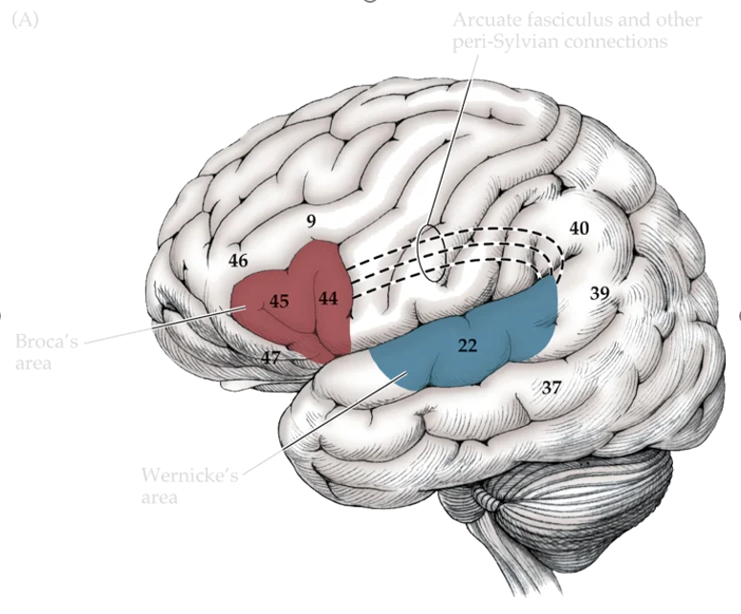

Mixtures of large-scale dynamic functional brain network modes
A general question: What is the functional brain network
Language modes
In Broca’s area, injury altered the capacity for speech production, while in Wernicke’s area, damage impacted the ability to comprehend language.
One of our focus, as statisticians, are studying the gray matter (the "processors") and how it is connected and interacts through the white matter (the "wires").

Slide 2

Introduction
Dataset used in this paper: Electrophysiological data
· Electrophysiological data refers to brain activity data recorded using electrophysiological techniques, includes:
(1) EEG - Electroencephalography.
(2) MEG - Magnetoencephalography (this paper used this one!)
(3) ECoG - Electrocorticography
· Note: These three technologies are all used to record and analyze brain activity, but the way signals are collected is different:
(1) EEG uses scalp electrodes to record frontal cranial potentials.
(2) MEG uses a superconducting magnetometer to record brain magnetic fields (signals).
(3) ECoG uses electrodes implanted under the cerebral cortex to directly record EEG
Properties of this type of Dataset：
· They are all electrical signals that directly measure the activity of brain neurons, with high temporal resolution (at the ms level). However, the spatial resolution is relatively poor, and the signal detected by a sensor is a mixture of contributions from many surrounding brain regions (In our way of speaking, it is mainly a hight frequency time series data with but relatively bad spatial characteristics).
· The dataset that Zudi and I have been working on recently is the fMRI (functional magnetic resonance imaging) dataset, which mainly measures cerebral blood flow signals with low temporal resolution (in seconds) but high spatial resolution.
· Conducting such research also requires the use of source localization techniques to estimate activity signals in different brain regions. This article uses the beamformer source localization algorithm to locate 42 brain regions and obtain the source signals of each brain region as electrophysiological data for modeling and analysis.

Slide 3
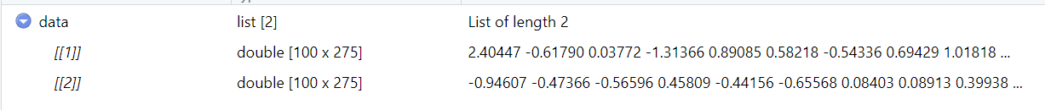
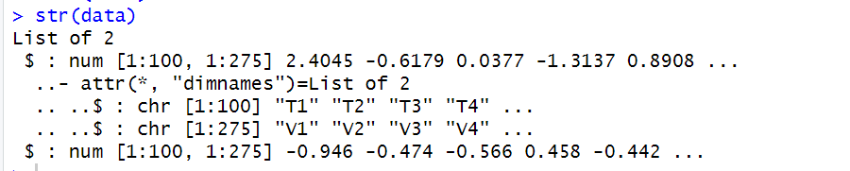
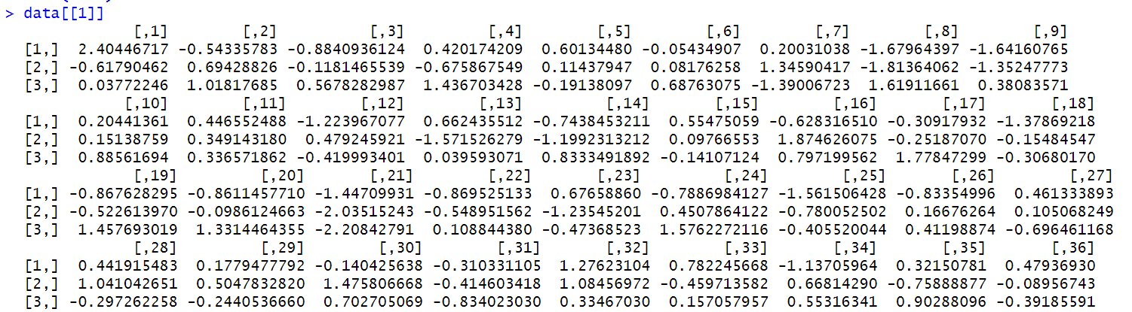
Objective: Build a model that capture highly dynamic processes on the order of milliseconds

Slide 4
Sliding window analysis，HMM and DyNeMo
Heuristic analysis VS Generative Model

Slide 5

Generative model
1 Modes
· Definition: Modes are static spatial patterns (can overlap with each other) or states of brain network activity, representing specific brain regions' activity characteristics in certain states or activity modes.
· Representation: Each mode j is characterized by its spatial model's mean μ_{j} and covariance D_{j}. These parameters describe the average relationship and variability of activity levels between different brain regions in that mode.
2 Generative model
① Latent representation : A set of mixing coefficients α_{t}
② Observation model (a data generating process given the latent representation): a multivariate normal distribution. (How do we define it?)
******************************************************************************************************
Considering a linear combination of modes, for a time point t, the predicted mean and covariance of the brain network state can be expressed as the weighted sum of all modes, i.e.,
where α_{jt} is the mixing coefficient of mode j at time t.
***********************************************************************************************************************************************************************
Thus, "modes" provide a method to capture the spatial characteristics of the brain network in different states, with temporal dynamics reflected through the variation in the mixing coefficients.

Slide 6
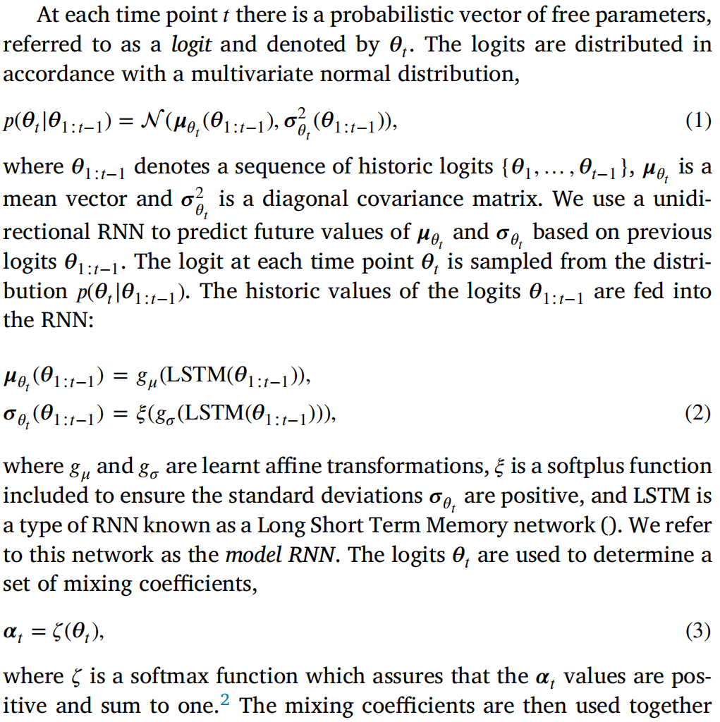

3 Logit
These logits are key parameters used within the model to describe the dynamic characteristics of the data generation process.
Probabilistic vector of free parameters at time point t
Learnt Affine Transformations: y=Wx+b, where W is the weight matrix, b is the bias vector(learned from the data during the training process), x is the input vector, and y is the transformed output.
Softplus Function: softplus(x)=log(1+e^{x}) .

Slide 7
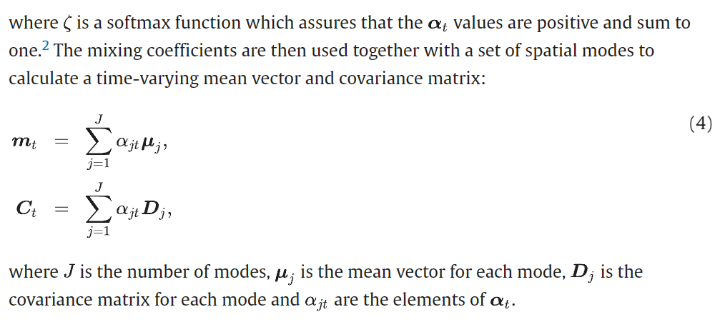
An important question
*******************************************************************************
The relationship between μ_{θt} and μ_{j} reflects how the model combines dynamic mixing coefficients at different time points (e.g., μ_{θt}) with static modes (e.g., μ_{j}) to describe the state of the brain network. Specifically:
μ_{j}: Represents the mean of the spatial model for a specific mode j, which is static and reflects the average activity level between brain regions in that mode (the spatial patterns mean μ_{j} can be preset based on a priori knowledge of the specific brain network pattern and continue to update during training process.)
μ_{θt}: Represents the predicted mean of the overall network state at time t, which is dynamic and calculated based on a linear combination of different modes and their mixing coefficients.
In this framework, μ_{θt} is typically calculated by combining the mean μ_{j} of each mode with the corresponding mixing coefficients, thus capturing the temporal dynamics of the brain network.

Slide 8
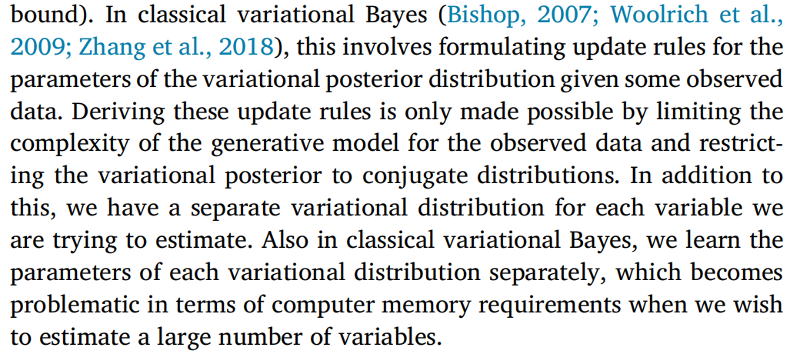
Improved variational Bayes for parameters estimation
Classical Variational Bayes introduces a simplified variational distribution q_{φ}(Z) to approximate the posterior distribution P(Z|X) , controlled by parameters φ. The goal is to find such φ that makes q_{φ}(Z) as close to P(Z|X) as possible, typically achieved by minimizing the Kullback-Leibler (KL) divergence:
By maximizing the Evidence Lower Bound (ELBO):
The first term is the expected likelihood, reflecting the model's fit to the data, and the second term is the KL divergence between the variational and prior distributions, acting as a regularization term. Variational Bayes optimizes φ to maximize ELBO, finding the best variational distribution q_{φ}(Z), making it an effective method for approximate inference.
Difficulties

Slide 9
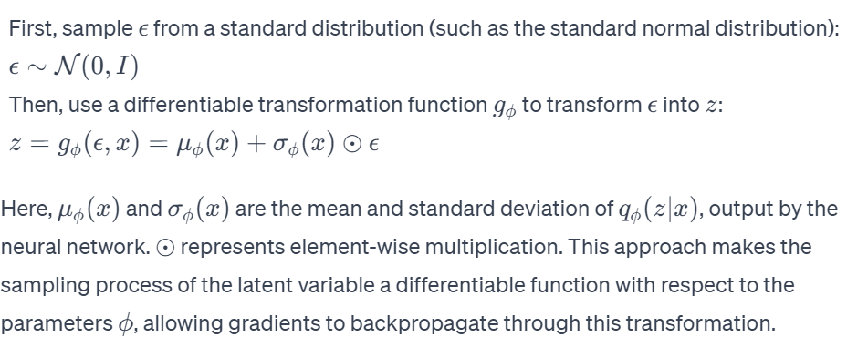
Improved variational Bayes for parameters estimation
Variational autoencoders(VAE) reparameterization trick
· Amortized Inference:
Traditional Variational Bayes requires individual optimization of variational parameters for each data point, which is time-consuming for large datasets. Amortized Inference overcomes this by "learning" these parameters through a neural network (inference network), avoiding repetitive optimization for each sample.
· Reparameterization trick and optimization
Helping us to learn a full posterior distributionfor θ_{t} (Kingma and Welling, 2014). We learn point estimates of μ_{𝑗} and
D_{𝑗} using trainable free parameters. We update estimates for μ_{𝑗}, D_{𝑗}, and the posterior distribution parameters of θ_{t}, to minimise the variational free energy (Kullback-Leibler divergence between the variational and true posterior, or equivalently, maximising the evidence lower bound) using stochastic gradient descent (backward propagation).
· Reparameterization trick

Slide 10
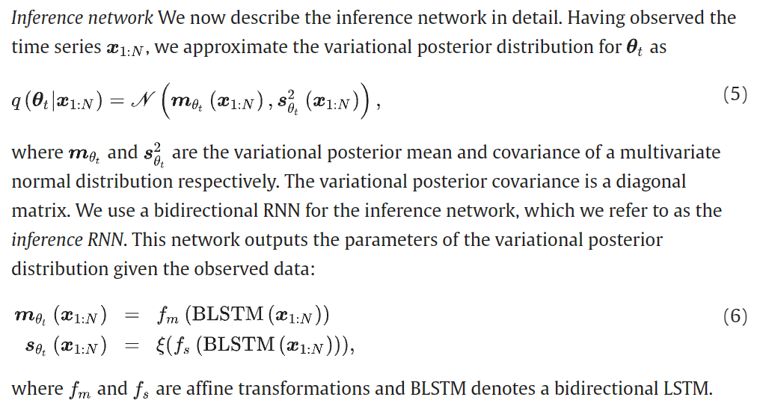
Inference network

Slide 11
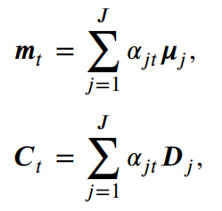
Sum up --- DyNeMo(Dynamic Network Modes)
The DyNeMo model is a generative model for neuroimaging data, treating functional brain networks, including functional connectivity metrics, as dynamic entities. It employs static spatial brain activity patterns termed "modes", linearly combined to define time-varying data statistics. Key elements include:
1. Latent Representation: Dynamic mixing coefficients, denoted α_{t}.
2. Observation Model: A multivariate normal distribution, whose mean and covariance are computed by linearly mixing the spatial models mean μ_{j} and covariance D_{j} of modes with α_{t}.
Parameter estimation in DyNeMo involves using an inference network, a type of neural network (like LSTM), to learn the mapping from observed data to latent space. The reparameterization trick is applied to learn the full posterior distribution of θ_{t}. This is coupled with stochastic gradient descent to minimize variational free energy, updating model parameters.

Slide 12
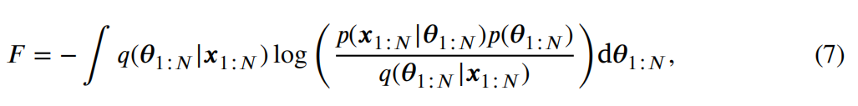
Loss function —— Definition
In the DyNeMo model, the calculation of the loss function involves two main parts: Negative Log Likelihood (-LL) and Kullback Leibler Divergence (KL). These two parts together constitute the Variational Free Energy, which is used to minimize for model training. The negative logarithmic likelihood part is mainly responsible for the accuracy of data reconstruction, while the KL divergence part is responsible for the similarity between the posterior and prior distributions of potential variables.
Note: This is essentially the negative evidence lower bound of VB.

Slide 13
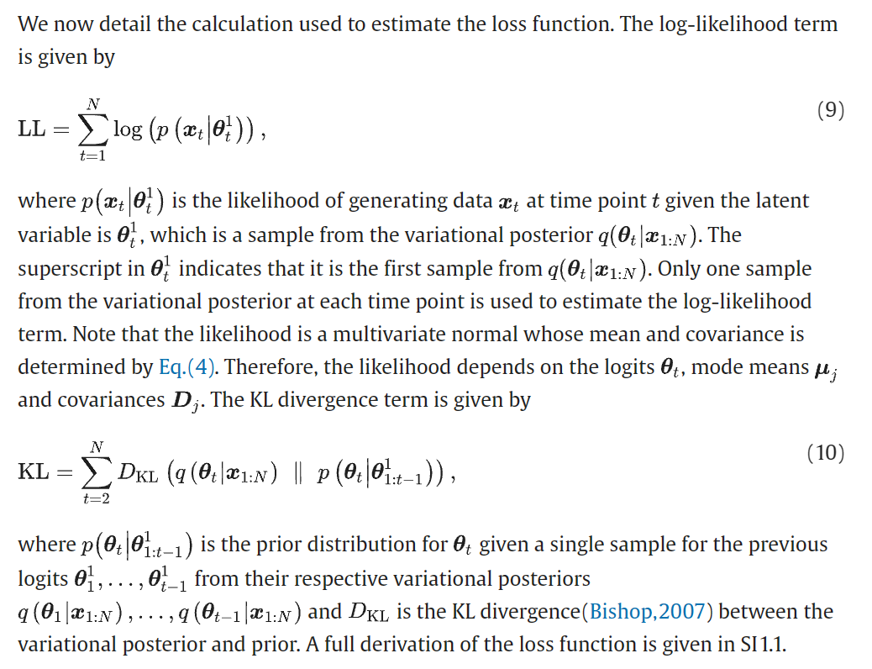
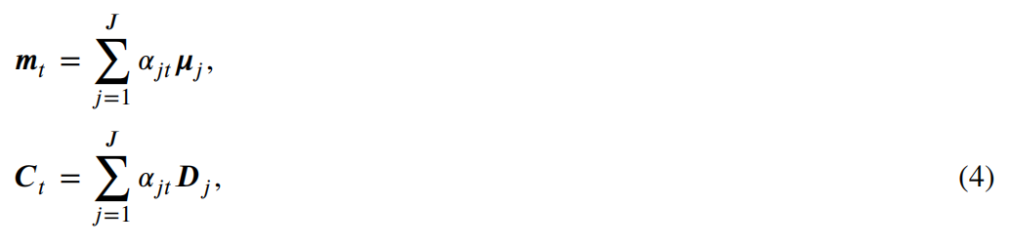
Loss function —— Calculation
Logit represents an instance of latent variables that are not directly observed data but are inferred from the observed data. These logits are predicted by the output of a neural network (such as an RNN) and are used to determine the parameters of the multivariate normal distribution, thereby affecting how the model generates data. Therefore, although the logit in some sense represents a "decision" or "state" of the model, they are still considered implicit in the context of the model because they are inferred rather than directly observed amount.

Slide 14
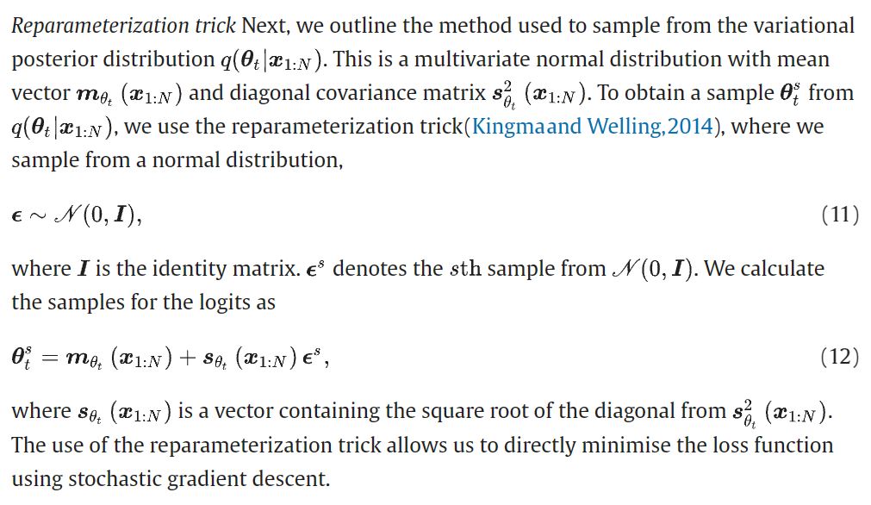
Reparameterization trick

Slide 15
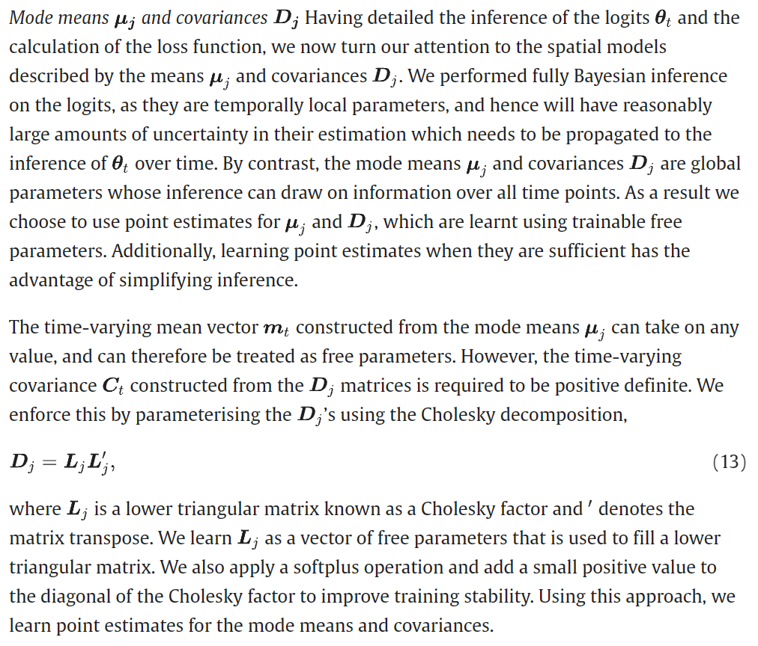
Mode means and covariances
semi-pd

Slide 16
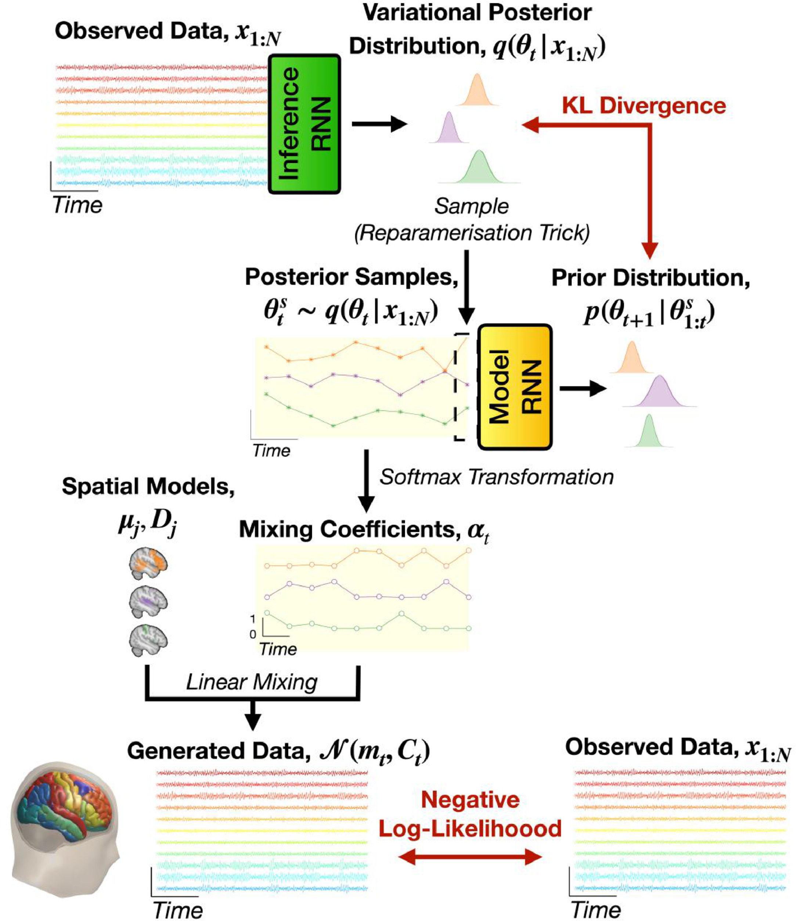
DyNeMo(Dynamic Network Modes)

Slide 17
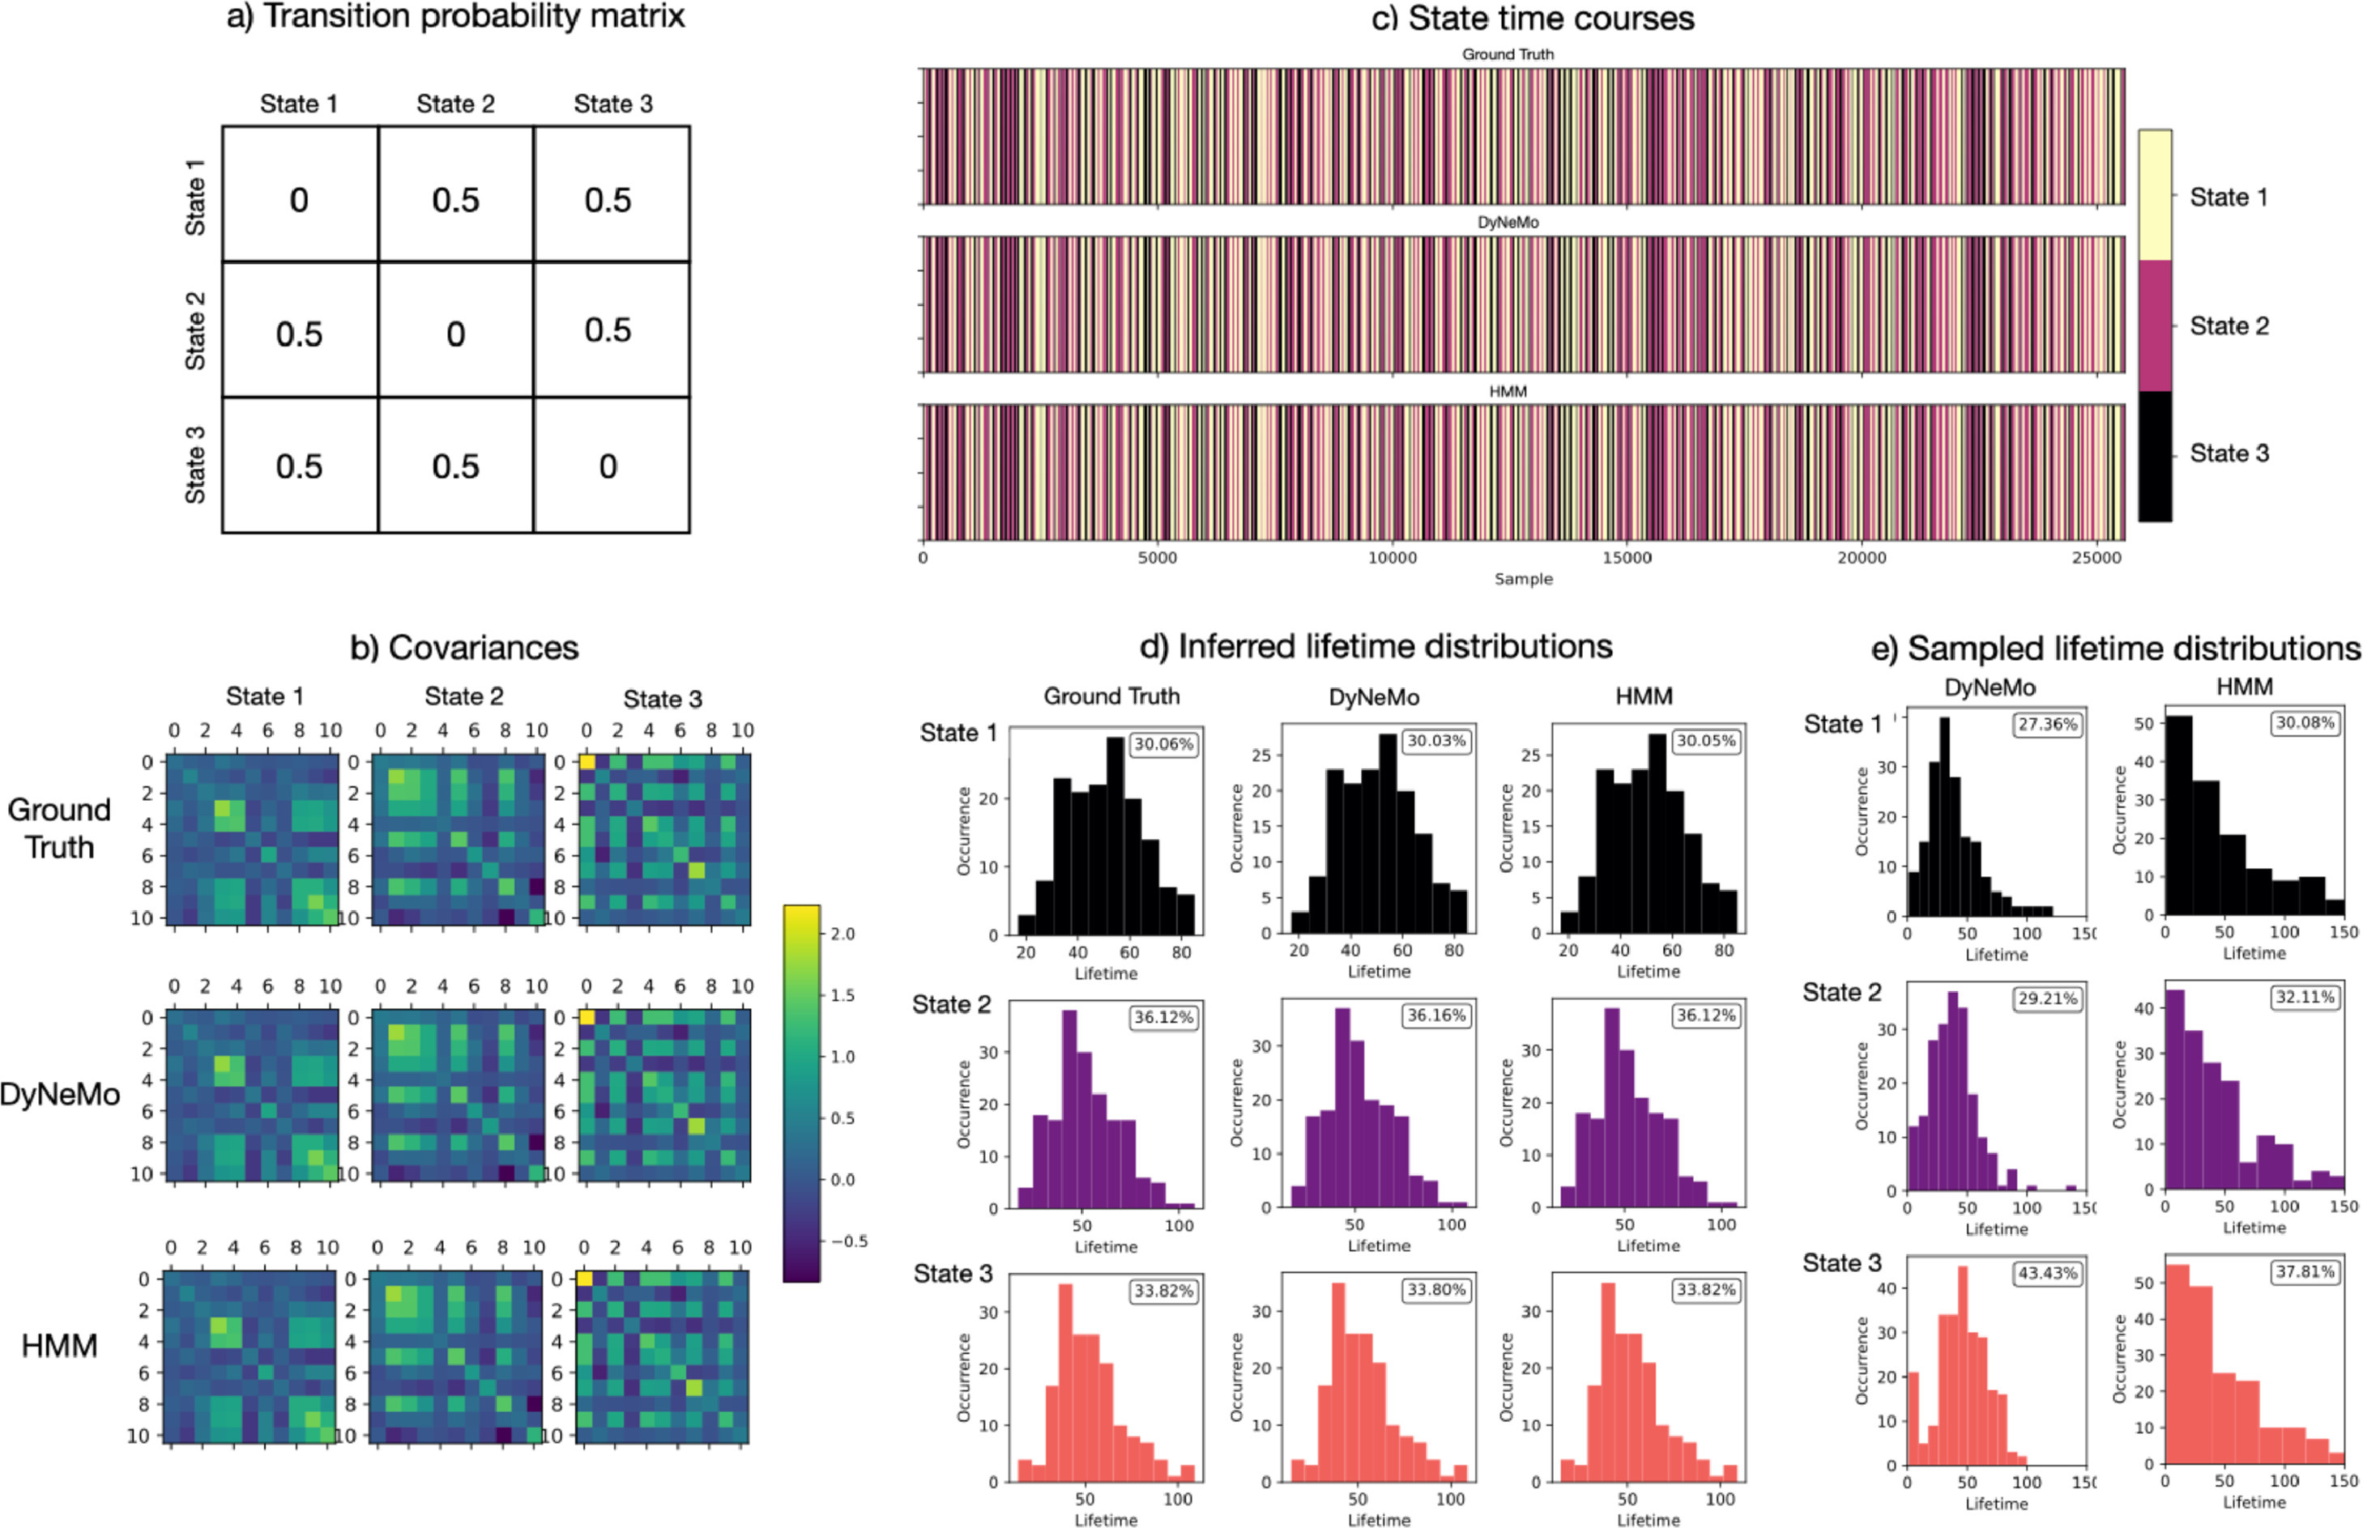
Simulation
1. Hidden Semi-Markov Model: We use a transition probability matrix with self-transitions excluded to determine the sequence of states to sample a lifetime for. The transition probability matrix and ground truth mode covariances are shown in Fig. 4a and b respectively. A multivariate time series with 11 channels, 25,600 samples and 3 hidden states was generated using an HSMM simulation with a multivariate normal observation model. A zero mean vector was used for each mode and covariances were generated randomly. The ground truth state time course and lifetime distribution of this simulation is shown in Fig. 4c and d respectively.

Slide 18
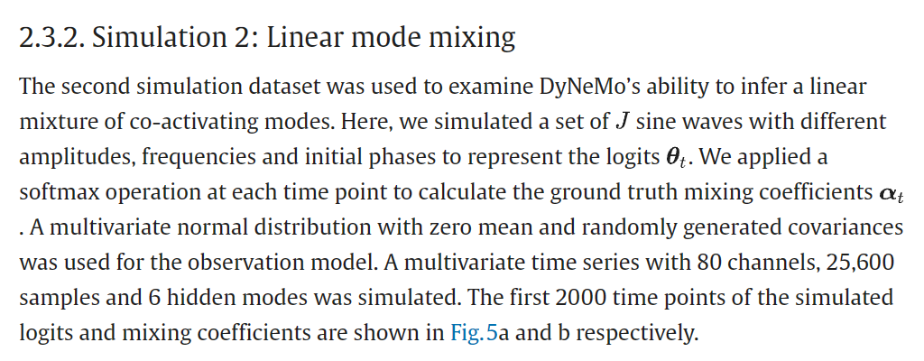
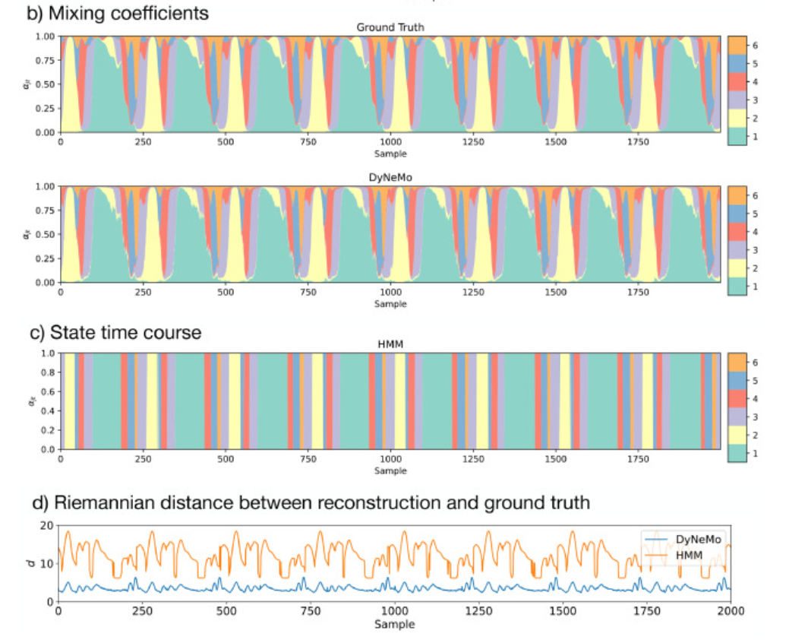
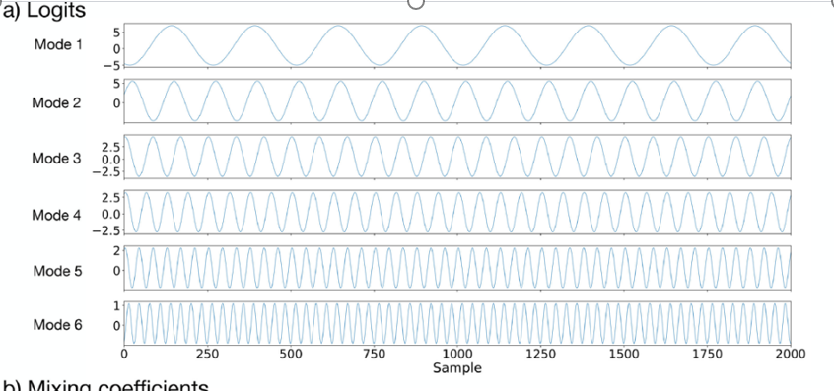
Simulation

Slide 19
Real data
This part of the data comes from the brain activity data of subjects collected using the 275 channel CTF MEG system. After preprocessing, signals from 42 regions of interest were reconstructed. In terms of data processing, the first step is to perform bandpass filtering on the original MEG data to remove power line noise, and apply independent component analysis (ICA) to remove eye movement and electrocardiogram interference. Then, structured grating imaging technology was used to image the brains of the subjects, and MEG data was registered with anatomical images. The preprocessing steps used include delay embedding, which is achieved by adding additional channels to encode time information, thereby increasing the number of channels to 630. In addition, PCA dimensionality reduction and standardization (z-transform) were also carried out to facilitate the processing of large amounts of data.
Channel: usually refers to independent signal recordings obtained from MEG (magnetoencephalogram), EEG (electroencephalogram), or other neural recording devices. Each channel corresponds to a sensor on the device, which measures the electromagnetic activity of the brain at different locations. Therefore, when referring to the 275 channels of MEG data, this means that there are 275 independent sensors recording brain activity data at the same time. These channel data can then be used to analyze brain function, detect neural activity patterns, identify changes in cognitive processes, and so on.
Note: resting-state datasets refer to data collected while participants are at rest, not engaged in any specific task, allowing for the study of the brain's intrinsic functional connectivity. Task datasets, such as a visuomotor task, involve data collected while participants are engaged in a specific task, in this case, likely one involving visual and motor functions.

Slide 20
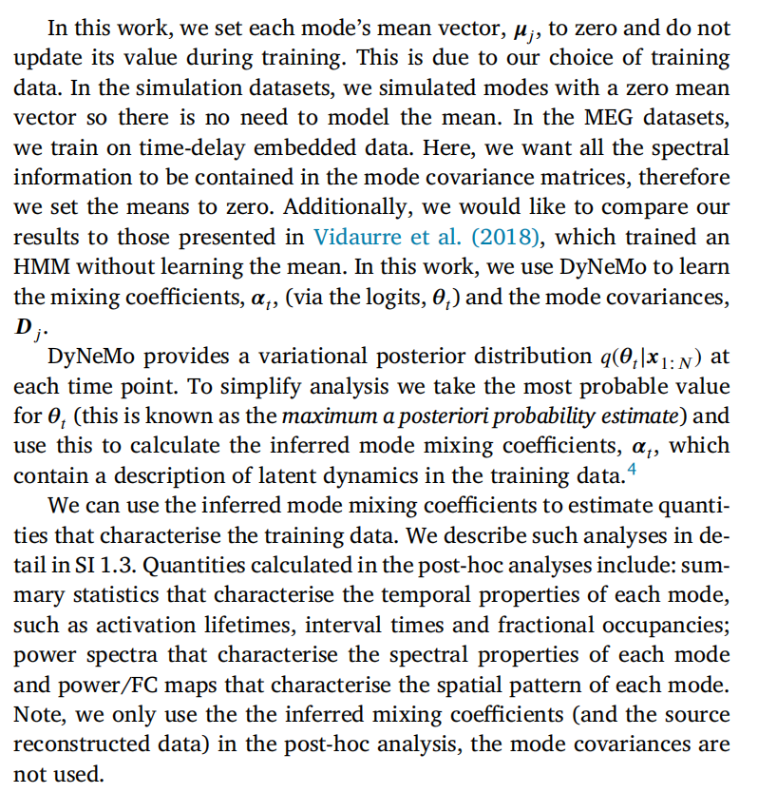
Post-hoc analysis of learnt latent variables

Slide 21
Result

Slide 22
Model evaluation and some extra Proof
To be continued...

